Slide 1

Behavior Pattern:
State Pattern
00

Slide 2

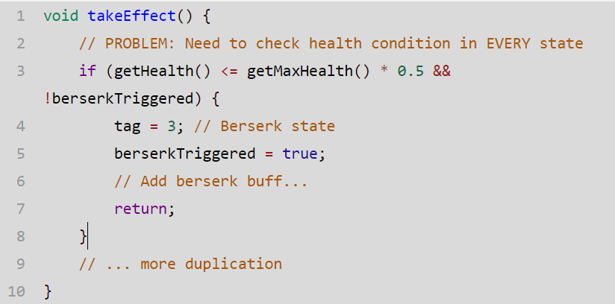
Behavior Pattern: State Pattern
Monster State Refactoring
Before
Overview
Change the class of the object by encapsulating state-specific behavior into Separate State Classes.
Issue Before Refactoring
1.Mixed Responsibilities: Behavior logic and state transition logic are intertwined in a single method
2.Code Complexity: With nested if-else, adding more states or conditions quickly becomes unmaintainable
3.Testing Challenges: Cannot test individual states in isolation

Slide 3
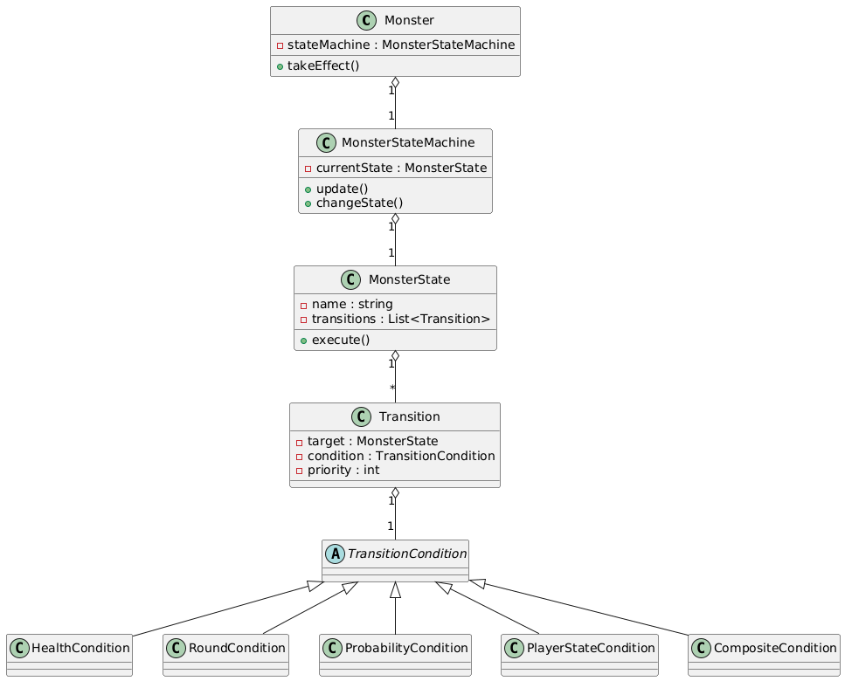
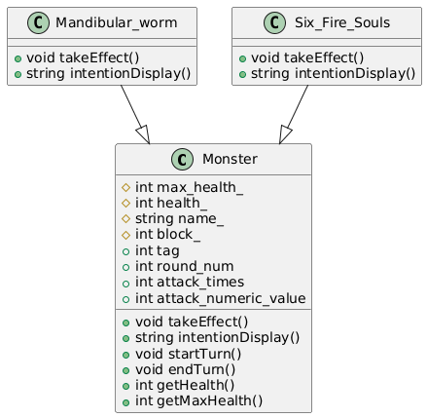
Behavior Pattern: State Pattern
UML Changes
After
Before
Refactor Overview
1.Separation of Concerns: Conditions, States, and StateMachine are independent
2.CompositeCondition: Combine multiple simple conditions using logical operators like AND/OR

Slide 4
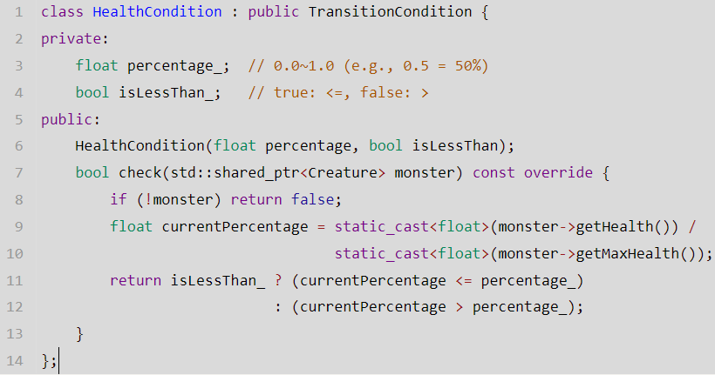
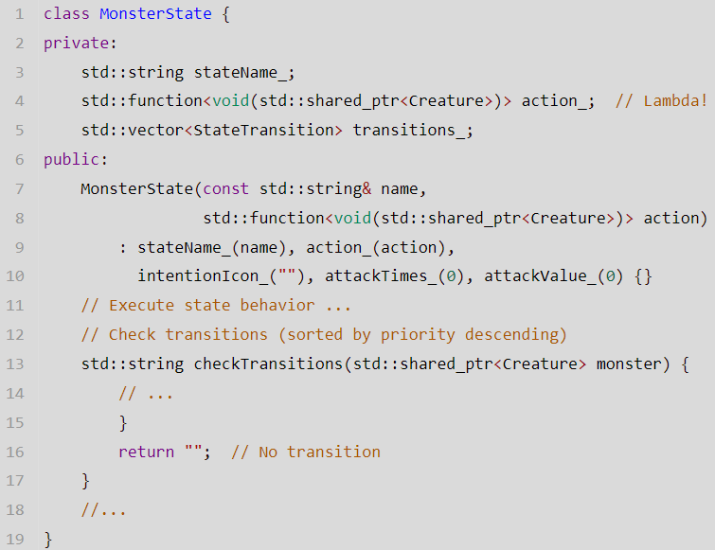
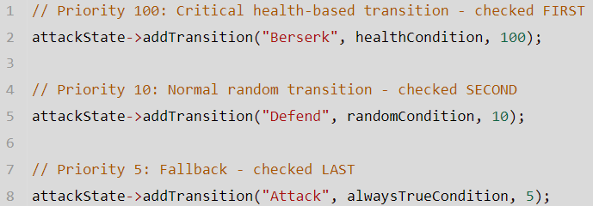
Behavior Pattern: State Pattern
Detailed implementation
1. Condition Definition
2. State Definition
3. State Transition

Slide 5
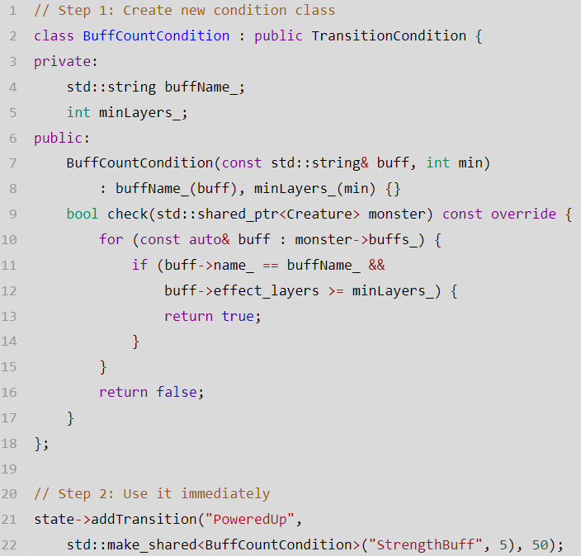
Behavior Pattern: State Pattern
Detailed implementation
Future Extensions
Advantages
1 Separation of Concerns
After refactoring, the action of the state and the transition logic are cleanly separated.
2 Code Reusability
With reusable `TransitionCondition` classes, any change to the condition is automatically reflected
3 Support for Complex Conditions
`CompositeCondition`can combine multiple simple conditions using logical operators like AND.
4 Easy Testing
By modeling behavior as states, transitions, and conditions, each piece becomes independently testable.

